Slide 1
IS Project - Interview
Group 4 - Kelven, Chun Kai, Zachary, Chong xiang

Slide 2
Youths and their contribution to society

Slide 3
Background information
https://cityofgood.sg/articles/10-youth/
The volunteers shown in the article did not have amazing skills or accomplished groundbreaking feats
There was one who helped the deaf community by adding subtitles to videos
And there was another who went around his neighborhood and got to know the residents there, which helped built a sense of community.
(City of Good, 2017)

Slide 4
Background information
https://www.todayonline.com/commentary/volunteers-can-gain-they-give
National Volunteer and Philanthropy Centre’s (NVPC’s) 2018 Individual Giving Study
70 per cent of Singaporeans are keen to volunteer, and over 60 per cent of them make donations in cash or in kind.
Singapore’s national volunteerism rate stood at just 29 per cent

Slide 5
T08, Assessment 1
Lim wee liang Kelven
S10221788

Slide 6
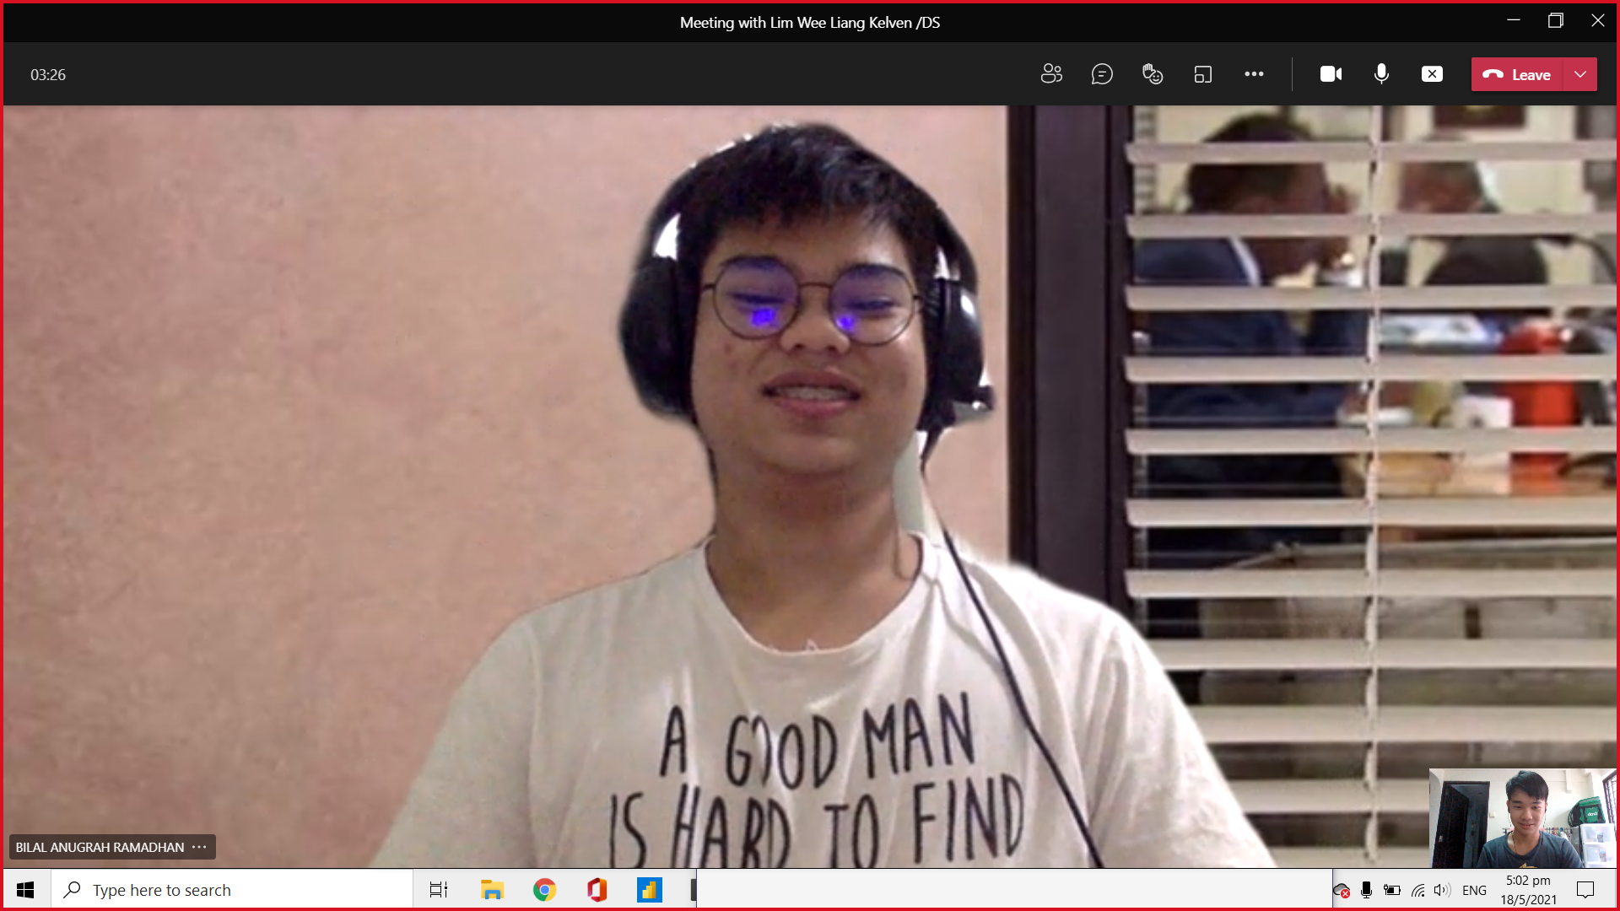
Background on Interviewee
This is Bilal
Youth Corp member since secondary school
Participated in various events like raising awareness of online scams and beach cleanups
Volunteering from a young age helped him broaden his perspective
Lim Wee Liang Kelven

Slide 7
Interviewee questions

Slide 8
Question 1
What made you join National Youth Corps (NYC)?
Open-ended, probing
Get to know the speaker and his passion for joining NYC
Response
Introduced to youth corps during secondary school
Decided to stay as a member after graduation because he found the activities fulfilling, such as beach cleanups and raising public awareness
Lim Wee Liang Kelven

Slide 9
Question 2
How should youths contribute to our society?
Open-ended, clarifying
To find out different ways youths can contribute to society (ie. individual or groups)
Response
Bring a smile to others
Individually or organisations
Can be done through simple acts like returning your trays or helping out at events
Lim Wee Liang Kelven

Slide 10
Question 3
Why do you think some youths do not volunteer in their free time?
Open-ended
To find out if youths do not volunteer due to a lack of motivation
Response
Lack of motivation
May use free time to study more or to relax from studying
No physical reward
Lim Wee Liang Kelven

Slide 11
Question 4
Are youths given sufficient resources to make a change in their communities?
Close-ended, clarifying
To find out if youths are not volunteering due to lack of resources
Response
Yes, but...
Aren't given enough authority to organise their own events
Might not be taken seriously (eg. people might walk away from them)
Lim Wee Liang Kelven

Slide 12
Question 5
Should there be an equal emphasis on volunteerism as education?
Open-ended, probing
To find out if volunteering in schools should use up as much time as education
Response
Yes
Gain experience on current issues and motivation
Can fix issues after graduation
Lim Wee Liang Kelven

Slide 13
reflection

Slide 14
As with all online meetings, there were some technical hiccups like audio and camera.
I realised beforehand that I would not be able to record down his responses while he talks. To solve this, I had prepared to record the meeting.
I also had to explain to him that the recording would only be for educational purposes and the responses would be supporting materials for the project.
Being able to use the different question types made it easier to structure questions, and to gain clarity and understanding of the topic.
Before the meeting, I was expecting him to say things like “You need to do this”, however he was relaxed and said “You can do anything”.
Lim Wee Liang Kelven

Slide 15
T08 assessment 1
S10222222
Lim Chun Kai
Notes:
-Introduce myself

Slide 16
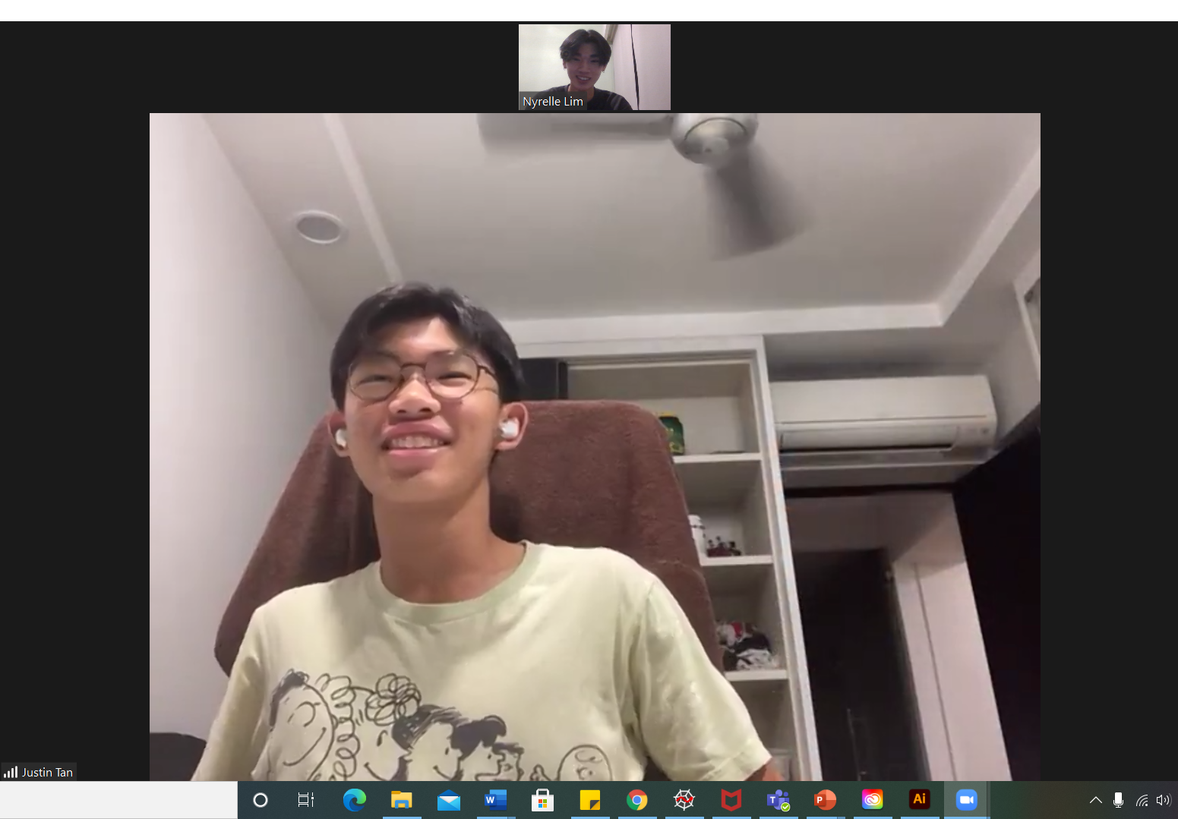
Interviewee profile
A student at Saint Andrew Junior College
A year 2 student
A volunteer at OpenJio
Lim Chun Kai
Notes:
-Talk about what OpenJio is (organisation focusing on social volunteerism)

Slide 17
Reasons for choosing my interviewee
Active volunteer
Might have reasons for volunteering
Within age range to be a youth
Relevant to the topic
Lim Chun Kai
Notes:
-2 Reasons
-Topic is (Youths and their contribution to society)

Slide 18
Impact on my interviewee
Helps to mature at a young age
Provide a new perspective on life
Develop soft-skills and knowledge for the future
-Creativity, teamwork, leadership, problem-solving
Lim Chun Kai

Slide 19
Interview questions
Lim Chun Kai

Slide 20
Question 1: You mentioned that you enjoy what you are doing, why is that so?
Question type: Clarifying and Open-ended
Purpose:
-Light-hearted question to start
-Let interviewee be free to talk about anything
-Get to know interviewee better
RESPONSE:
In OpenJio, feels a sense of belonging
Allows him to connect with people with the same interests and goals
Nice to have people you know doing the same thing and supporting you
Most importantly, he enjoys seeing the fruits of his labours (people smiling)
Lim Chun Kai
Notes:
-Clarifying because he mentioned that he enjoys volunteering beforehand
-Start interview off light-heartedly
-Know interviewee better
-Read bolded points

Slide 21
Question 2: what is it that drives you to do such work at a young age?
Question type: Open-ended
Purpose:
-Still get to know the interviewee better
-Find out his interest and motivations
RESPONSE:
Feels that the social sector of volunteerism is underlooked as people are not willing to sacrifice time and effort into physical volunteerism though they are willing to help less fortunate
As such, people resort to simplest form of volunteerism such as donating money
Still thinks that donation is greatly appreciated but greatly intrigued as to the lack of physical social volunteerism
Being a part of OpenJio allows him to try and change that with the help of other members
Lim Chun Kai

Slide 22
Question 3: do you still see yourself doing this in the future? If yes, where do you see yourself in a few years time?
Question type: Close and open-ended
Purpose:
-See how committed he is to volunteerism
-How volunteerism is going to affect his life
RESPONSE:
Definitely does see himself continuing volunteerism in the future
May not have as much time in his hands currently in view of his upcoming exams, but will do his part in trying his best to give to others
Lim Chun Kai

Slide 23
Question 4: Do you see yourself as a role model for future youths? Yes/no why?
Question type: Probing and open-ended
Purpose:
-See how he views himself/what his doing
-Probe for the next question
RESPONSE:
Does not necessarily say so as volunteerism is not the only good deed there is
However, he wants to be an example to others that regardless of age or background, anyone can bring joy and hope to those around them
Lim Chun Kai

Slide 24
Question 5: if there is one thing you would like to tell other youths hoping to make a change /contribution to society, what would it be?
Question type: Open-ended
Purpose:
-A closure for the interview
-Get a key takeaway
RESPONSE:
When representing an organisation, be it volunteering or anything else, you are a direct representation of the organisation
Hence, there is no room for half-hearted work and you must remain professional at all times
Even if you cannot commit fully, if you start on any volunteerism you should finish what you started
Most importantly, possess the following traits: integrity, reliability and passion
Lim Chun Kai

Slide 25
Reflection
Despite doing the interview through a screen at home, it was still pretty nerve-wrecking
I expected my interviewee to be extremely formal but he was surprisingly relaxed during the interview which helped ease my nerves
At the start, one difficulty faced was recording down the responses as I was writing down the responses which was too slow
However, I decided to record the audio which allowed me to playback and note down the responses correctly while paying full attention to my interviewee’s responses
I was able to use the different types of questions (E.g Probing) which I learnt from my Communication Essentials lessons to help structure my questions better, making the interview a smooth experience for both me and my interviewee
I learnt that a lot of details and effort can be put into the smallest, or unnoticeable things that can improve the work I produce
In conclusion, it was an unforgettable experience
Lim Chun Kai
Notes:
-After finish, pass on to Zachary

Slide 26
TO8 Assesment S10192640 Zachary Kegan Sim

Slide 27
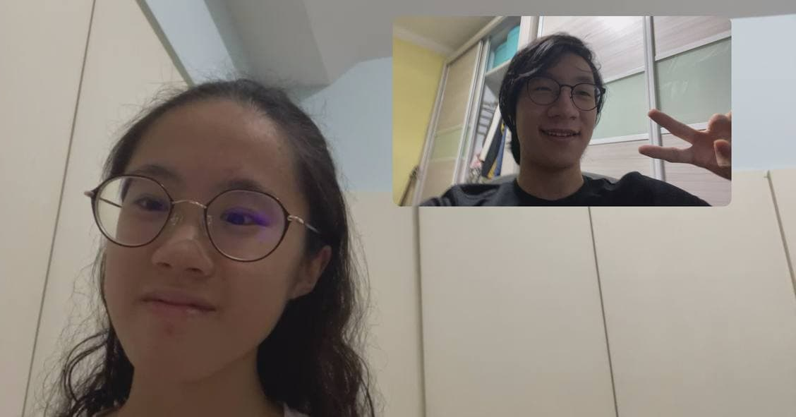
Interviewee Profile
Aw Ying Xiu, Lilian
16, Student in NP
-Student Councillor
-Student Volunteer
-Studied in New Town Secondary School
-Currently studying in Early Childhood Development in NP
Why did I choose this candidate? She has a lot of experience in volunteering and student leadership, both of which positively contribute to society. She is also a youth, so it relates to the topic.
Zachary Kegan Sim Yanxi

Slide 28
Interview Questions

Slide 29
Q1: How do you think that your actions has impacted society? (Probing)
I think that my leadership initiatives and volunteering have positively impacted society as I feel like I was able to do my part and contribute to cleaning up living spaces during cleanup volunteering sessions, and accompany young children and watch them grow when I was volunteering in my kindergarten. I think being a student leader in my secondary school also positively impacted the school environment as I was able to aid in maintaining order and rules in school, which would positively influence the students.
I asked this question because I wanted to understand how Lilian felt about leadership and volunteerism
Zachary Kegan Sim Yanxi

Slide 30
Q2: What actions have you done in your past that had positively contributed to society? (Clarifying)
I had volunteered for cleanup sessions, such as at West Coast Park, East Coast Park as well as Botanic Gardens. I also had previously volunteered at my kindergarten over my holidays to give me some experience in child development, which is the course I am in right now. I also contributed as a student leader in my secondary school, as well as volunteered in food donation drives. I feel that these past experiences have positively influenced society.
I asked this question as I wanted to find out why she values her volunteer and leadership work.
Zachary Kegan Sim Yanxi

Slide 31
Q3: How do you think the government is willing to support the things that you do? (Sin, 2020) (open-ended)
I think that the government will not mind funding volunteering efforts as it is relatively cheap and cost effective on their end, and also allows for the youths of Singapore to take part in efforts that go a long way for our society.
I asked this question as I wanted to know what she feels about the government in relation to this subject.
Zachary Kegan Sim Yanxi

Slide 32
Q4: How do you feel about spending your time to help others? (Open-ended)
I am always happy to spend a bit of my time for other people! Be it friends, family or complete strangers, I think it is a good thing to lend a helping hand to anyone that might need it. I don't mind spending a little bit of my own time to enhance other people’s lives, or just help around in the community.
I asked this question to find out if she has ulterior motives such as merits in her report book.
Zachary Kegan Sim Yanxi

Slide 33
Q5: Is volunteering fulfilling to you? (Close-ended)
Yes, of course! Helping others has always been fulfilling for me, and seeing my efforts pay off in real time makes me feel great. Getting thanked by the less fortunate, and seeing the kids in the kindergarten grow up, always feels great.
I asked this question to find out if she is volunteering willingly or if it is due to external factors such as pressure and grades.
Zachary Kegan Sim Yanxi

Slide 34
Reflections
I think that this interview project was interesting for many reasons. It allowed me to bond with someone i barely knew and it gave me insight to the happenings in student leadership positions.
Zachary Kegan Sim Yanxi

Slide 35
T08 Assessment 1
Seng Chong Xiang S10222597

Slide 36
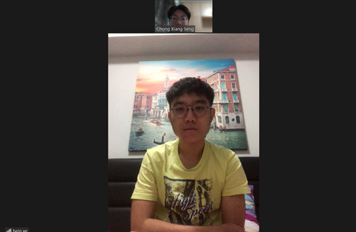
Interviewee profile
A year 2 student in SP’s Community Service and Cultural Club (CSCC).
An active volunteer.
Extensive experience in doing community service.
Seng Chong Xiang

Slide 37
Interview questions
Qn 1: Have you contributed to the society? If yes, in what ways do you contribute to the society? (Open-ended/close-ended)
Purpose: To discover how youths contribute back to the society, and retrieve more information regarding the topic.
Responses:
Through Value-In-Action projects organised by my secondary school, I got to contribute back to the society by visiting the old folks home and going around the neighbourhood near the school to collect recyclables.
After secondary school, I worked together with my group of friends to thank the healthcare workers last year for their unrelenting efforts in tackling the virus since the pandemic struck Singapore terribly last year.
Seng Chong Xiang

Slide 38
Interview questions
Qn 2: What are your thoughts on how youths nowadays can contribute to the society? (Open-ended, Probing)
Purpose: Recommendations supported by reasons, gives a multi-perspective approach to the topic.
Responses:
Youths nowadays can contribute back to the society by providing daily necessities to the low-SES (socio economic status) people and spend more time accompanying them and understand their problems.
Since low-SES strongly correlates with poverty, it has become a pressing problem in developed countries like Singapore.
Seng Chong Xiang

Slide 39
Interview questions
Qn 3: Do you think that contributions to the society are important/ essential, why? (Open-ended, Probing)
Purpose: How youths and their contributions are actually helpful to the society.
Responses:
They are of course essential as contributions to the society are improvements to the society.
Important to care for people who require assistance like the low-income, the disabled and the other unfortunates as you will feel more contented and livelier by doing so.
Seng Chong Xiang

Slide 40
Interview questions
Qn 4: Which area do you think society today needs the most help in? (Open-ended)
Purpose: Open-ended question, allows us to understand from interviewee’s point of view.
Responses:
The low-income people and the disabled people.
I feel that they are those who need the most assistance, be it in terms of monetary help or physical help.
Even though our government has done a lot, I feel that everyone should put in their part to actively offer help them whenever encounter such situations.
Seng Chong Xiang

Slide 41
Interview questions
Qn 5: Do you agree that “Youths have the strongest impact on society and therefore, they play the most important role.” Why or why not? (Leading, Open-ended)
Purpose: Contentious question, to know the interviewee’s stance and why he/she thinks this way and to understand from a different point of view.
Responses:
(next slide)
Seng Chong Xiang

Slide 42
Interview questions
Responses:
Yes, I do agree that the youth have the strongest impact on the society.
Personally I feel that youths are the backbone of today’s society and that they determine the future of our country.
For example: after someone retires from his job, his position needs to be replaced by the younger people. Therefore, this shows that the other age groups in the society rely on youths as they are responsible for advancements in the technology, education, healthcare or the defence system in the country after the older generation step down.
Seng Chong Xiang

Slide 43
reflections
It was an interesting and special experience for me as it was my first time conducting an interview on a stranger. During the interview, we encountered a few technical issues and so we had to pause and wait for the internet to regain to continue with our questions. Apart from the short interruptions, the overall interview was very successful and through my interviewee’s response, I have learnt that there are many people out there who actually benefited from all the contributions made to the society and more youths are stepping up to help people who are in need.
Seng Chong Xiang

Slide 44
analysis

Slide 45
Opportunities
Challenges
Lesser and lesser people tend to offer their help as the society advances
As youths are busy with studies, they may not be able to commit time to volunteering
Through VIAs (Values in Action) or service learning conducted by schools, youths can broaden their perspectives on life
Technology can be used to make volunteering more appealing to youths
Notes:
Kelven then Chun Kai

Slide 46
recommendations

Slide 47
Recommendations regarding our topic
Starting up an organisation to rally youths across the nation to contribute back to the society
Encourage youths to continue suggesting their ideas even though they may be rejected. This may encourage authorities to support their initiatives
Youths should better manage their time, so that they can volunteer more in their free time
Notes:
Zach then Chong Xiang

Slide 48
Citations

Slide 49
City of Good. (2017, August 10). 10 Youths Making Singapore A Better Place. Retrieved from https://cityofgood.sg/articles/10-youth/
Tan, J. (2019, June 19). Volunteers don't just give, they gain. Retrieved from TODAY Online: https://www.todayonline.com/commentary/volunteers-can-gain-they-give
Notes:
Chong Xiang continue

Slide 50
Thank you
Notes:
Good job guys

